Slide 1
Exam 2 Analytics Q3
Andrew Fish

Slide 2
Modeling Betting Volume
Variable | Model1 | Model1^ | Model2 | Model2^
Intercept | -12135.37* | -118494* | -107985.3* | -107985.27*
absSpread | -2115.11 | -3172* | -2141.2 | -2141.17.
absSpread | -74.76 | NA | NA | NA
Total | 6605.27*** | 6606*** | 6770.1*** | 6770.11***
RoadFav | -7971.59 | -7967 | -4678.6 | -4678.62
Week of Season | NA | NA | -2542.9 | -2542.93
Both of the models were checked for multicollinearity and heteroskedasticity. Model1^ is Model1 corrected for multicollinearity and Model2^ is Model2 corrected for heteroskedasticity
Original starting point was attempting to replicated the models of Paul & Weinbach paper with just betting related data. Then added Week of Season in attempt to replicated month dummies.
Thought was to have the betting data combined with the time of season data. Assuming more hype for NFL at beginning of season compared to end
Significance levels: . is 10%, * is 5%, ** is 1%, *** is 0.1%

Slide 3
Testing the Models
Model | BP Test | White Test | ANOVA
Model1^ | 6.9502 | 2.5358 | NA
Model2 | 12.624* | 7.7462* | NA
Model2^ | NA | NA | 10.144**
Variable | Model1 VIF | Model1^ VIF | Model2 VIF
absSpread | 8.34 | 1.04 | 1.1
absSpread^2 | 8.3 | NA | NA
Total | 1.01 | 1.01 | 1.01
RoadFav | 1.04 | 1.04 | 1.06
Week of Season | NA | NA | 1.06
From the BP and White tests it is seen that in Model2 we can reject the null hypothesis of no heteroskedasticity and must correct for that. As well Model2^ is significantly different from Model1^ with the addition of Week of Season
The VIF results show an issue with absSpread and absSpread^2. The removal of absSpread^2 helps eliminate this issue

Slide 4
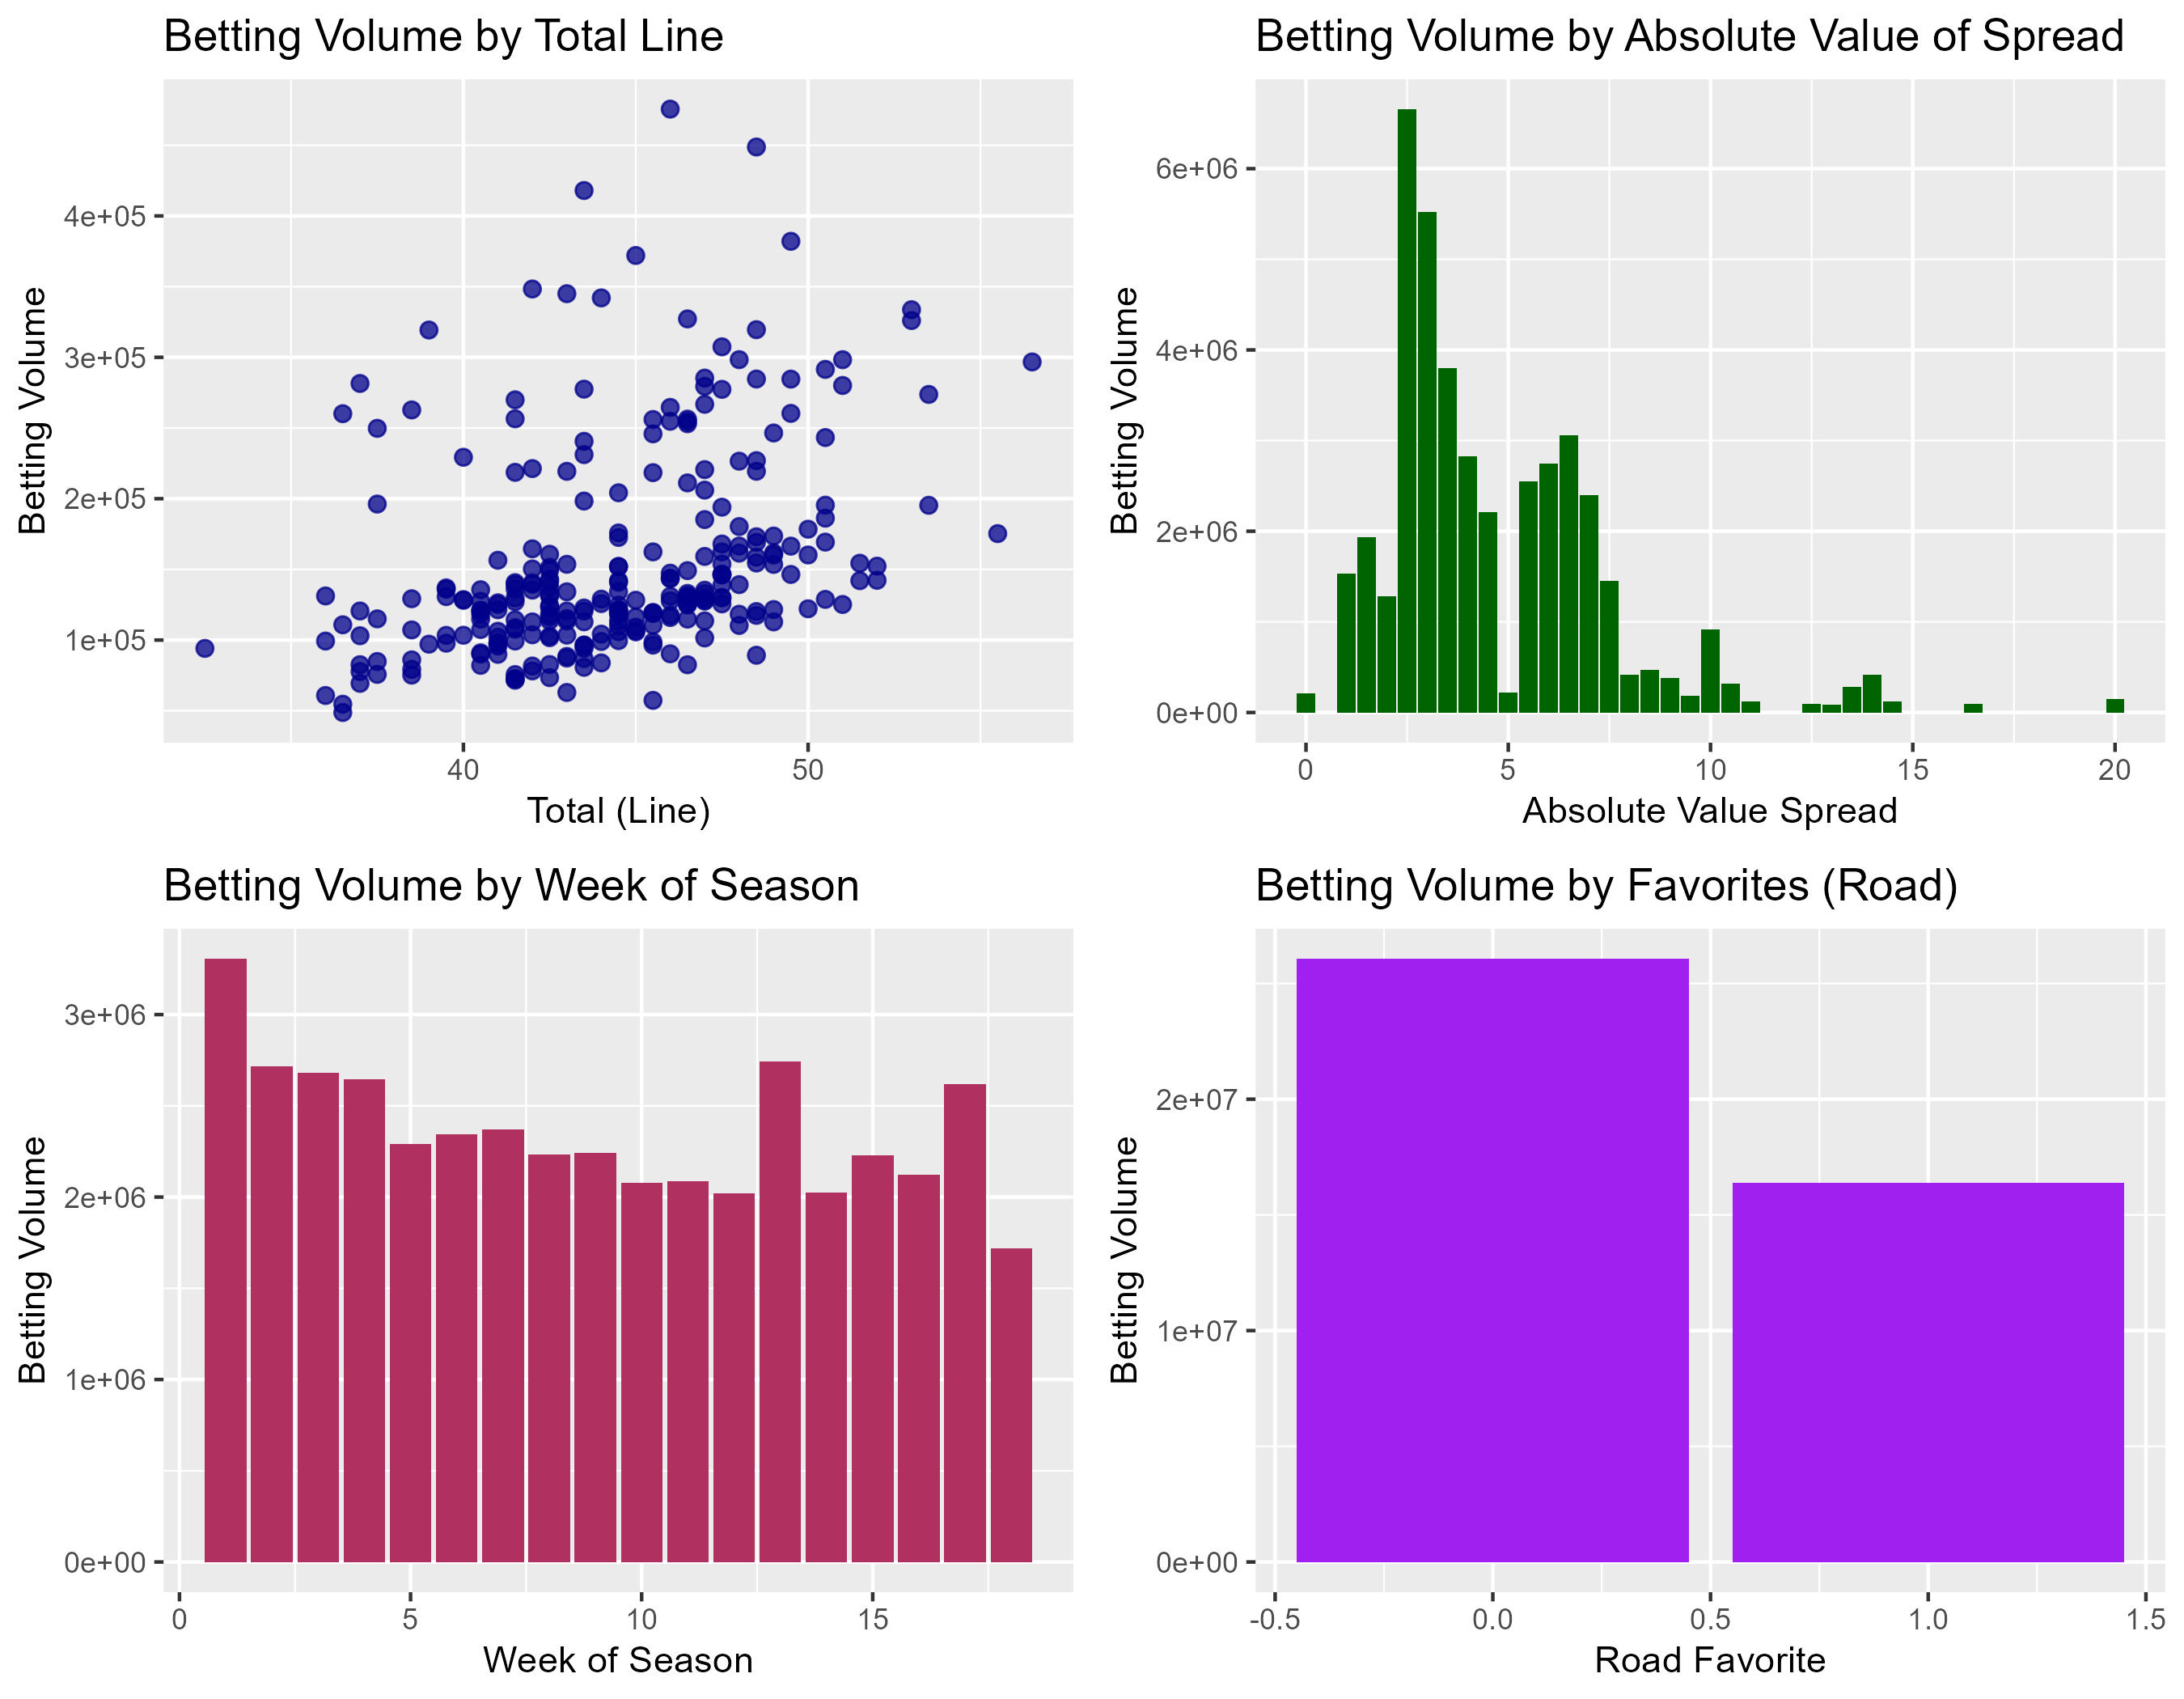
Relationship Between Volume and Variables
Total shows bettors preferring higher scoring games
The Spread shows higher volume of bets are placed on games that have a smaller absolute value of spread. Resulting in predicting a closer game
As the season goes on the bettors tend to bet less often with some spikes later in the season
There is a slight preference to betting against Road Favorites meaning the bettors prefer the Home Team to win over the Road Team
These trends confirm what the coefficients are communicating in Model1^ and Model2^

